Slide 1
The Doula
Danielle Little, MAEd
Maternal Child Health Professional
Doula – Childbirth Educator – Lactation Counselor

Slide 2
AGENDA
Define the term doula
Discuss the role of a birth doula
Discuss the benefits of continuous labor support
Discuss the scope of the postpartum doula

Slide 4
What is a Doula?
”A trained professional who provides continuous physical, emotional and informational support to their client before, during and shortly after childbirth…”

Slide 5
Role of the Birth Doula
Prenatal
Labor and Birth
Immediate Postpartum
Information & Advocacy
Provide Resources
Communication
Physical Support
Informational Support
Continuity of Care
Lactation Support
Newborn Care
Physical and Emotional Support

Slide 6
Prenatal
Education & Advocacy
Birthing Process
Labor and Birth Positions
Lactation
Facilitate Effective Communication

Slide 7
Labor and Birth

Slide 8
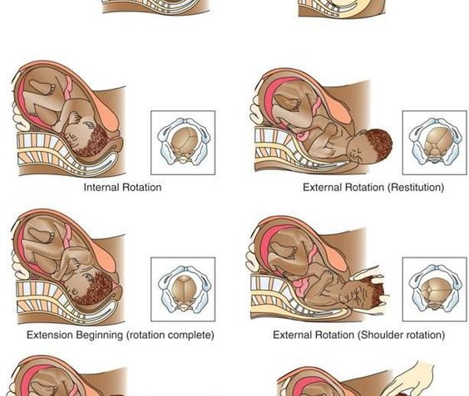
Labor and Birth

Slide 9
“Continuous support in labor may improve a number of outcomes for both [the birthing person] and baby, and no adverse outcomes have been identified. Continuous support from a person who is present solely to provide support, is not a member of the [person’s] own network, is experienced in providing labor support, and has at least a modest amount of training (such as a doula), appears beneficial.” Cochrane Database Systematic Review, 2017

Slide 10
Benefits of a Doula
Physical Support
Emotional Support
Clinical Benefits
Increased movement
Improved relaxation
Comfort and reassurance
Lactation support
Decreased anxiety
Increased confidence
Boosted self esteem
Improved postpartum mental health
Family bonding and support for partners and siblings
Reduced use of Pitocin
Fewer requests for pain meds
Less likely to need forceps and vacuum
Greater satisfaction with the overall birth experience
More positive long-term memories
Better APGAR scores for baby*
Reduced likelihood of cesarean birth

Slide 11
Postpartum Doula

Slide 12
Role of a Postpartum Doula
Nurture
Educate
Assist
Reassure

Slide 13
THANK YOU
Danielle Little, MAEd
Danielle.Little@trianglehealtheducators.org

