Slide 1
FHLI Doula Roundtable
Rachel Peragallo Urrutia, ACURE4Moms Co-Principal Investigator
December 13, 2022
MOMBABY.ORG/ACURE4MOMS

Slide 2
How to decrease maternal health disparities?
Community-Based Doula support
ACCURE* study:
Developed by the Greensboro Health Disparities Collaborative (GHDC) with UNC, Cone Health, and University of Pittsburgh Medical Center (UPMC)
Eliminated lung & breast cancer disparities between Black and White patients at Cone Health & UPMC Cancer Centers
*ACCURE=Accountability for Cancer Care through Undoing Racism and Equity

Slide 3
Stakeholder Advisory Accountability Board Leading with Equity (STABLE)
(Oversight of Study Design & Dissemination)
Christina Yongue (Co-Chair)
Brittany Curry (Co-Chair)
Research Team
ACURE4Moms
Study Team
University of North Carolina (UNC)
at Chapel Hill (Primary Study Oversight) Jennifer Tang (Co-PI) Rachel Urrutia (Co-PI) Samuel Cykert (Co-I) Kate Menard (Co-I) Wanda Nicholson (Co-I) Sarah Verbiest (Co-I)
Marcella Boynton (Co-I)
Leah Gardner (Project Manager)
Rabab Hussain (Asst Project Manager)
Mountain Area Health Education Center (MAHEC) OB-GYN
(Racial Equity Training) Dolly Byrd (Co-I) Bill Gist (Co-I) Amanda Murphy (Co-I)
Community Advisory Members
Patients of color who have experienced low birth weight or severe maternal morbidity (5)
Community-based doulas (4)
Greensboro Health Disparities Collaborative
(GHDC) members (3)
Sistas Caring 4 Sistas
(Doula Training & Oversight for Western NC)
Cindy McMillan (Co-I)
Lisa Dix (Project Manager)
Policy Advisory Members
NC Division of Public Health representatives (2) NC Medicaid representative
Payer representatives (BCBS/Anthem, United, Wellcare) MomsRising representative
American College of Nurse-Midwives representative
NC Obstetrical & Gynecological Society representative
NC Provider Support Network representatives (2)
Sheps Center for Health Services Research
Data Analysis
Brian Cass (Deputy Director, Data Management and Information Technology)
Momma’s Village--Fayetteville (Doula Training & Oversight
for Eastern NC) Angela Malloy (Co-I)
Jasmine Johnson (Project Manager)
NC Health Information Exchange Authority (HIEA)
Perinatal Equity Dashboard & Maternal Warning System
Jenell Stewart
(Health Analytics Lead)
NC Area Health Education Centers (AHEC) Practice Support Program (Practice Facilitation) Chris Weathington
(Director, Practice Support)
Study Core Teams
Project Management
Practice Engagement
Data Interventions
Doula Interventions
Racial Equity Training
Implementation Research
Longitudinal Patient Surveys
Dissemination

Slide 4
ACURE4Moms Study Design
Four-arm cluster randomized controlled trial (RCT) of 40 practices:
1) Standard Care Management (Control Arm)→ 10 practices
2) Data Interventions-Only (Data Arm)→ 10 practices
3) Community-Based Doula Support-Only (Doula Arm)→ 10 practices
4) Data Interventions + Doula Support (Data+Doula Arm)→ 10 practices

Slide 5
ACURE4Moms Study Aims & Outcomes
Aim 1: Compare proportion of Black women who deliver a low birthweight baby between Arms (Primary Outcome).
Aim 2: Compare # ED/OB triage visits and hospitalizations during pregnancy and up to 1 year after delivery between Arms.
Aim 3: Explore trends in self-reported racism during pregnancy and up to 4 months after delivery between Arms through patient surveys.

Slide 6
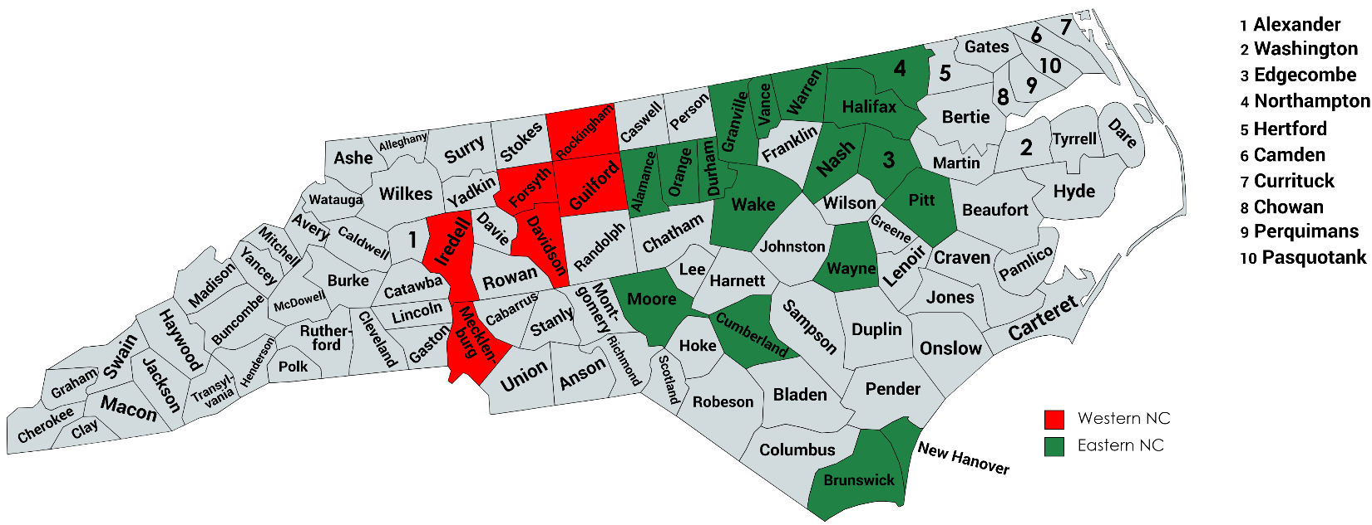
ACURE4Moms Sites

Slide 7
CBDs in ACURE4Moms
Members of the community they are serving (within 30 min drive to hospital)
Not employed by a health system or public health agency
No requirements or exclusions based on certification
Members of a collective for recruitment, training, support, payments and supervision
Momma’s Village Fayetteville
SistasCaring4Sistas
40 hours of training (past or current)
Birth support, Lactation support, Postpartum support, PMADs Support, Afrocentric birth and postpartum practices, Communications and more

Slide 8
CBD ARM Benefits and Expectations
Partnership and support from local Doulas in supporting patients at risk for LBW:
Points system for prioritizing patients for doulas based on LBW risk factors
Participate in shared patient care with Doulas:
Allow our Doulas to attend 2 prenatal visits with their clients
Allow our Doulas to attend deliveries at practice-affiliated hospitals
Doula support paid for by the study for 2 years
~6 births/month or 144 births total

Slide 9
MHEET Trainings
Based on ACCURE study
Race Equity Institute antiracism training topics adapted for healthcare
Topics: Transparency, accountability, gatekeeping, root cause analysis
Presented site-specific Clinical Performance Reports on patient outcomes by race
Multidisciplinary Conversations (all staff) to develop further solutions
ACURE4Moms
Historical context of maternal health disparities
Implicit Bias Simulations for reproductive healthcare
Doula orientation for practices and hospital staff
Collecting stories from people with lived experience
9 sessions over 2 years; 8 x 1 hour; 1 x 2 hours

Slide 10
Questions?
Rachel Peragallo Urrutia: rachel_peragallo@med.unc.edu
Jennifer Tang: jennifer_tang@med.unc.edu
Angela Malloy: angela@mommasvillage.org
Cindy McMillan: cindy@sistascaring4sistas.org

